Slide 1


Under The Weather
Lucy Liu 2025

Slide 2
Demo
Concept
Goal
“Under The Weather” is a weather app that translates weather into emotional states, from data into feeling. Instead of “Rain: 72°F,” it says, “Feels like: At least you have an excuse to cancel plans now.”
Showing how people project feelings onto neutral information.
Concept
Audience
Inspiration
The people who check the weather and immediately relates it to their mood. but to interpret it as a sign from the universe. The type of person who says, “It’s raining again, of course it is,” and takes it personally.
NYC’s collective mood swings with its weather; how bright April mornings lift spirits, while gray October days drag them down.
Notes:
creds to daniel Shiffman and dan osullivan

Slide 3
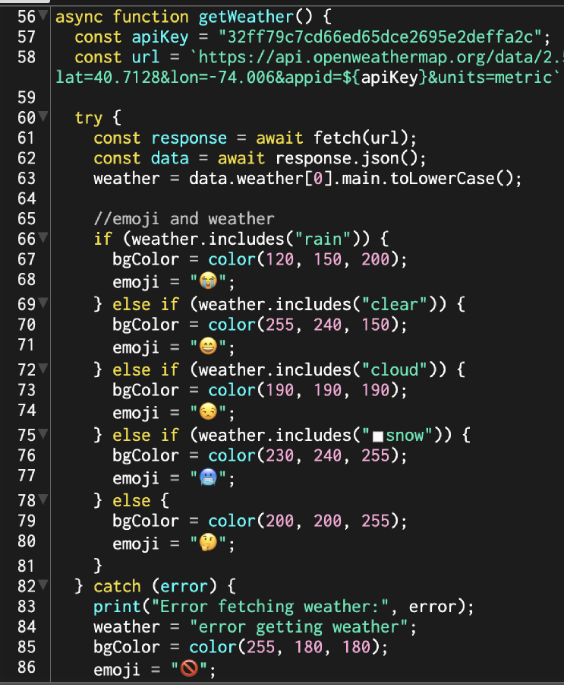



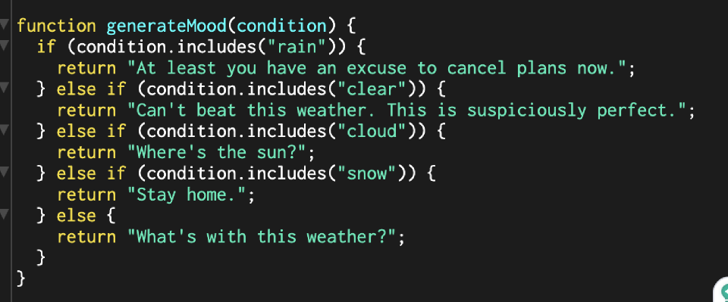


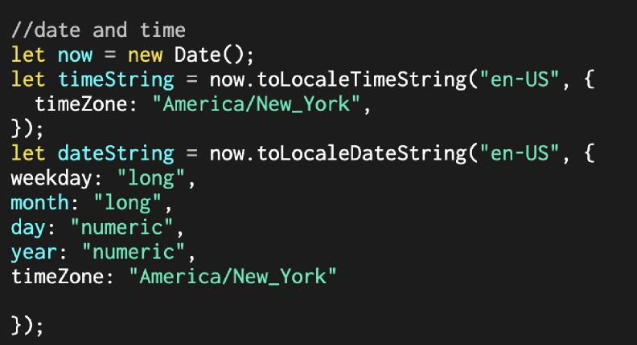
Uses the OpenWeatherMap API to fetch live NYC weather.
Converts API data into emotion using if/else logic.
Background color and emoji change with the forecast.
Added NYC time/date display and error handling if API fails.
Uses Javascript built in date object to put it in NYC time zone
Stored the weather data, color, and emoji in global variables.
Code Snippet & Explanation

Slide 4
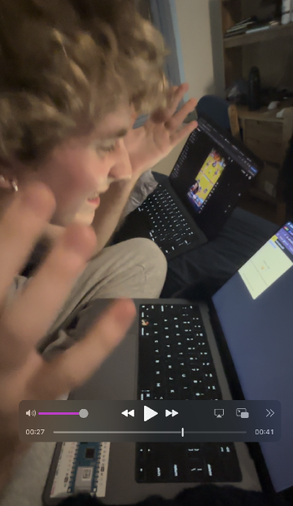
User Testing
Findings
Tried pressing the screen instead of the button. → Fixed by changing text to make it more clear
Suggested making users type in latitude/longitude for humor.
Next Steps
Add “feels like” line with richer emotional phrases and different options randomized.
Experiment with sound and gradient animation for weather moods.
Successes
API call worked and updated in real-time.
Colors and emojis matched weather conditions.
Test User: Michael Ryan Leese
User Testing Vid

Slide 5
Does this app successfully feel unnecessary, like it’s solving a problem that didn’t need solving?
Conceptual
Questions for Feedback

